Slide 1

Policy implications of SDGs
SWA SMM, Day 3 Technical Meeting
17th March, 2016
Tom Slaymaker
tslaymaker@unicef.org

Slide 2
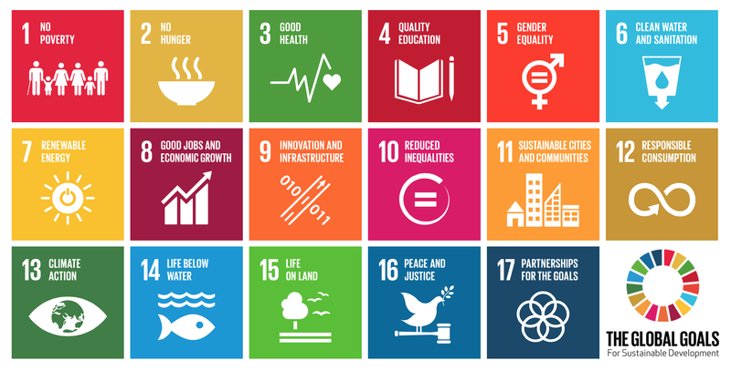
The 17 Sustainable Development Goals

Slide 3
Goal 6: Ensure availability and sustainable management of water and sanitation for all
Goal 6
6.3
Water quality
6.4
Water-use Efficiency
6.5
Water resource management
6.6
Eco-systems
6.2
Sanitation and Hygiene
6.1
Drinking Water
Means of Implementation
6.A
International cooperation
and capacity development
6.B
Local participation
Notes:
Member states decided on a single SDG goal for water and sanitation, that looks at the entire water cycle from the resource, to services, and back to the resource. The decision of member states is informed by the fact that all aspects of water touch on human development, and none should be looked at in complete isolation. Total of 8 targets and 11 indicators under SDG 6. Bearing this in mind, we will now focus closer on targets 6.1 and 6.2…those relating closest to the delivery of services and behaviour change.

Slide 4
Aspirational global targets
55. The Sustainable Development Goals and targets are integrated and indivisible, global in nature and universally applicable, taking into account different national realities, capacities and levels of development and respecting national policies and priorities. Targets are defined as aspirational and global, with each Government setting its own national targets guided by the global level of ambition but taking into account national circumstances. Each Government will also decide how these aspirational and global targets should be incorporated into national planning processes, policies and strategies. It is important to recognize the link between sustainable development and other relevant ongoing processes in the economic, social and environmental fields.

Slide 5
Role of Member States
Set national targets, review progress
78. We encourage all Member States to develop as soon as practicable ambitious national responses to the overall implementation of this Agenda. These can support the transition to the Sustainable Development Goals and build on existing planning instruments, such as national development and sustainable development strategies, as appropriate.
79. We also encourage Member States to conduct regular and inclusive reviews of progress at the national and sub-national levels which are country-led and country-driven. Such reviews should draw on contributions from indigenous peoples, civil society, the private sector and other stakeholders, in line with national circumstances, policies and priorities. National parliaments as well as other institutions can also support these processes.

Slide 6
Goal 6: Ensure availability and sustainable management of water and sanitation for all
Target 6.1: By 2030, achieve universal and equitable access to safe and affordable drinking water for ALL
Target 6.2: By 2030, achieve access to adequate and equitable sanitation and hygiene for ALL, and end open defecation, paying special attention to the needs of women and girls and those in vulnerable situations
Goal 6
6.3
Water quality
6.4
Water-use Efficiency
6.5
Water resource management
6.6
Eco-systems
6.2
Sanitation and Hygiene
6.1
Drinking Water
Means of Implementation
6.A
International cooperation
and capacity development
6.B
Local participation
Notes:
The SDGs include a goal on water and sanitation with ambitious targets for universal access to drinking water, sanitation and hygiene by 2030. This calls for a step change in current rates of progress as part of a wider effort to ‘end poverty in all it’s forms’ by 2030.
SDG targets were carefully negotiated by member states using very specific language (universal, safe and affordable drinking water for all, adequate and equitable sanitation and hygiene for all) with special emphasis on ending open defecation, needs of women and girls and those in vulnerable situations
These targets have been agreed by all countries and are applicable to all countries (low, middle and high income). Individual countries are expected to use them as a reference when developing their own national targets
How do we make sure we capture these multiple dimensions of «access» without losing conceptual clarity and rigour in measurement and monitoring?

Slide 7
Target 6.1: Drinking water
By 2030, achieve universal and equitable access to safe and affordable drinking water for all
6.1.1: Population using safely managed drinking water services
Definition: Pop. using an improved drinking water source which is:
located on premises,
available when needed, and
free of faecal and priority chemical contamination
Lead: WHO/UNICEF Joint Monitoring Programme
Accessibility
Availability
Quality

Slide 8
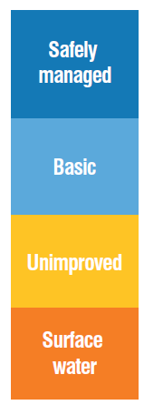
MDG/SDG | Service ladder | Progressive realization
SDG 6.1 | Safely managed drinking water | Improved facility located on premises, available when needed, and free from contamination
MDG continuity | Basic water | Improved facility within 30 minutes round trip collection time
 | Unimproved water | Unimproved facility does not protect against contamination
 | No service | Surface water
Developing Developed
Notes:
The proposed indicator for SDG target 6.1 is ‘Proportion of population using safely managed drinking water services’
This represents a higher service threshold and a new ‘rung’ at the top of the drinking water service ladder used by JMP during the MDGs
The ladder aims to capture progressive improvements from no service at all (surface water) and use of unimproved water sources (no protection against contamination), to using an improved water source (helps protect against contamination) which was the old MDG standard. If you have an improved facility close to home (within 30 minutes) this is now classed as a basic level of service (accessibility, quality, quantity) but the SDGs aim higher. In order to be classed as safely managed the improved facility should firstly be located on premises (accessibility), secondly water should be available when needed (available), and thirdly it should be free from contamination (quality)

Slide 9
Where will the data come from?
Criterion | Household Surveys | Regulatory authorities
Availability | Is water always available when needed from your main drinking water source? | Reported hours of service (piped)
Accessibility | Is the main drinking water source located in the dwelling yard or plot? | Reported household connections (piped supplies)
Quality | Testing for fecal (and chemical) contamination in household surveys | Compliance with national standards, WSPs
Affordability?

Slide 10
Implications for Country X
Notes:
Let’s look at the policy implication for Country X, which achieved the MDG target, nearly the entire population – 98% - lives in households which use improved drinking-water facilities.
[Click]. Only 3% of those facilities take more than 30 minutes to collect water, so we would see 95% of the population meeting the new definition of a «basic drinking-water service» - (an improved source within 30 minutes).
[Click]. We don’t have much data on «availability when needed» but if we assume that all piped water supplies (7% of the population) are intermittent and assume that all boreholes deliver water when needed, we estimate 89% meet this part of the definition. Of course those are both crude assumptions
[Click]. Most of these supplies, in both urban and rural areas, are boreholes, and most are on premises. So 74% of the population would meet the «on premises» part of the safely managed indicator.
[Click]. However if we adjust that 98% for water quality, we find that only 58% of sources are free from faecal contamination.
[Click]. This preliminary analysis shows that total population meeting the new higher service threshold of safely managed drinking water services would be around 58%. Microbial contamination at the sources is what drives the numbers. By the way, the survey found that piped water supplies were more heavily contaminated than tubewells, so as piped water coverage increases, safely managed drinking-water services could actually go down, unless water quality is improved in the piped systems.

Slide 11
Target 6.2: Sanitation and hygiene
By 2030, achieve access to adequate and equitable sanitation and hygiene for all, and end open defecation, paying special attention to the needs of women and girls and those in vulnerable situations
6.2.1: Population using safely managed sanitation services including a handwashing facility with soap and water
Definition: Pop. using an improved sanitation facility which is:
not shared with other households and where
excreta are safely disposed in situ or
transported and treated off-site
Accessibility
Quality

Slide 12
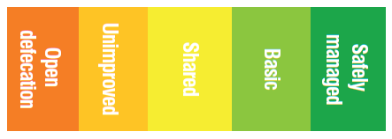
MDG/SDG | Service ladder | Progressive realization
SDG 6.2 | Safely managed sanitation | Private improved facility where faecal wastes are safely disposed on site or transported and treated off-site; plus a handwashing facility with soap and water
MDG continuity | Basic sanitation | Improved facility which separates excreta from human contact (private)
 | Shared sanitation | Improved facility which separates excreta from human contact (shared with other hh)
 | Unimproved sanitation | Unimproved facility does not separate excreta from human contact
 | No service | Open defecation
Developing Developed
Notes:
The proposed indicator for SDG target 6.2 is ‘Proportion of population using safely managed sanitation services including a handwashing facility with soap and water’
This represents a higher service threshold and a new ‘rung’ at the top of the sanitation ladder used by JMP during the MDGs
The purpose of the ladder is to capture progressive improvements from no service at all (open defecation) and use of unimproved latrines (fixed point defecation), to using a basic sanitation facility (which safely separates excreta from human contact). This was the old MDG standard and we distinguish between facilities which are private and those which are shared with other households. In order to meet the new SDG standard, you not only need to use an improved facility which is not shared with other households (now classed as basic) but the faecal wastes produced should either be safely disposed on site, or transported and treated offsite. This reflects a consensus that we need to address management of faecal wastes along the entire sanitation chain.
Last but not least the proposed global SDG indicator combines use of safely managed sanitation services and the presence of handwashing facilities with soap and water. This means that we will need to monitor handwashing much more systematically in future. Many countries already have data but we know that in many regions rates of handwashing are low.
So, every country has choices to make between moving people beyond the bottom rung, and helping people who are already on the ladder, to move further up. The mix of resource allocation and use of strategies will vary between countries, depending on their specific context. It is the purpose of this meeting to provide an overview of the common frameworks and tools available to support countries on this journey.

Slide 13
Containment
Emptying
Transport
Treatment
End-use/disposal
Offsite sanitation
27%
33%
Basic sanitation (BAP)
Onsite sanitation:
Septic tanks, pit latrines, VIPS, and other systems
6%
Shared services
Unimproved services
No sanitation services
Country Y
6%
11%
9%
41%
Source:

Slide 14
Where will the data come from?
Household surveys | Regulatory authorities
Sewer connections | Fecal wastes reach a treatment plant and adequately treated before discharge
Septic tanks - fecal wastes safely stored on site, or | Fecal wastes emptied and treated off-site
Latrines – fecal wastes safely stored on site, or | Fecal wastes emptied and treated off-site

Slide 15
Country Y
33
35
83
74
33
35
74
Notes:
First, the standard household surveys tell us that 83% of the population lives in a household that uses an improved sanitation facility.
[CLICK] And of course the JMP doesn’t count shared facilities, and if we discount those we see 74% of the population using improved sanitation.
[CLICK] From the famous ‘shitflow’ diagram we have seen that in Country X while 62% of the population has sewer connections, less than half of the faecal sludge is actually treated (27%).
[CLICK] Among those who use improved facilities which are not connected to a sewer, we know that 8% use septic tanks and 4% use pit latrines. Data shows that around half of these are are emptied and treated offsite.
[CLICK] Let’s assume that the rest of the pit latrines are never emptied and can therefore be considered safe (2%) but that half the faecal wastes from septic tanks are unsafely discharged into the local environment.
[CLICK] So that gives us a total of 35% safely managed sanitation services in Country Y.

Slide 16
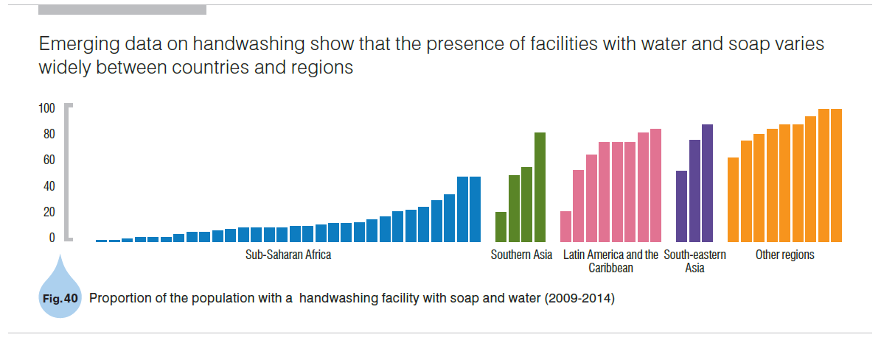
Target 6.2: Sanitation and hygiene
By 2030, achieve access to adequate and equitable sanitation and hygiene for all, and end open defecation, paying special attention to the needs of women and girls and those in vulnerable situations
Population using safely managed sanitation services including a handwashing facility with soap and water
Standard question in MICS and DHS since 2009
Observation by survey teams
Data available from 50+ countries
Accessibility
Availability
Notes:
The proposed indicator for hygiene is the proportion of population with handwashing facilities with soap and water at home
This can be observed in household surveys and has been a standard question in MICS and DHS since 2009
The data collected so far for over fifty countries show great variation between regions and many countries with extremely low levels

Slide 17
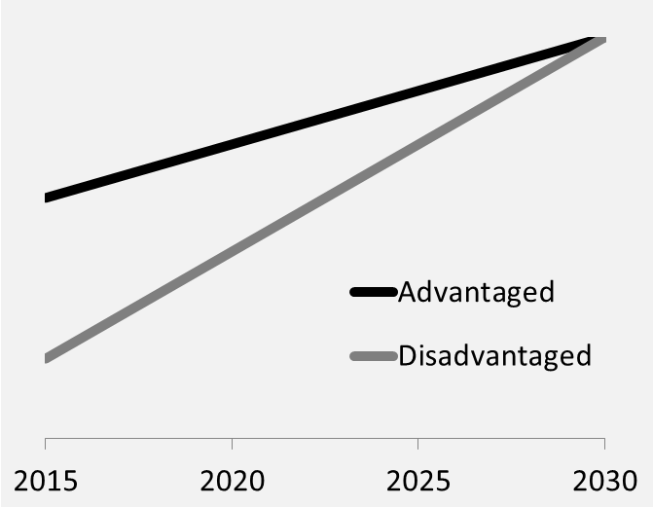
SDG targets 'leave no one behind'
SDG indicators to be disaggregated where relevant
  income,
  sex,
  age,
  race,
  ethnicity,
  migratory status,
  disability and
  geographic location,
  or other characteristics

Slide 18
Reserve slides

Slide 19
between countries

Slide 20
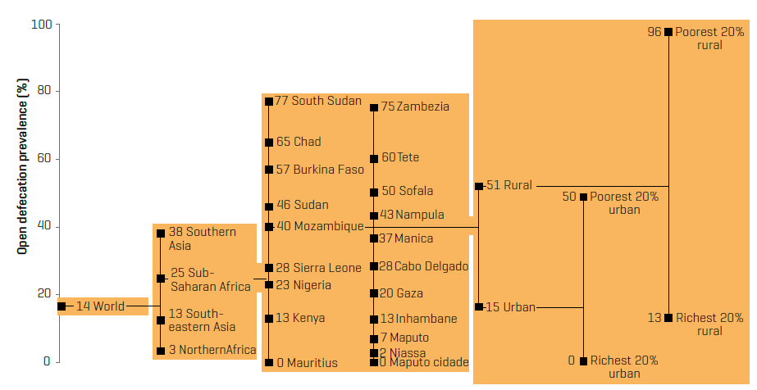
within and among countries

Slide 21
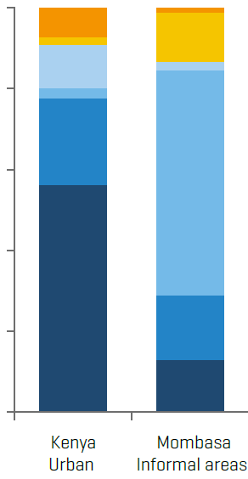
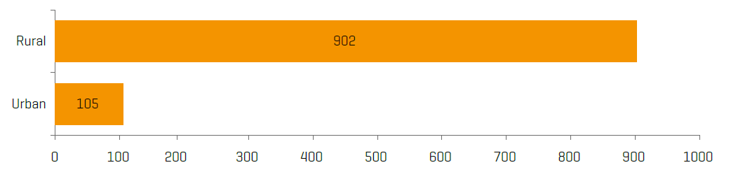
between urban and rural
Population practising open defecation in urban and rural areas, 2012

Slide 22
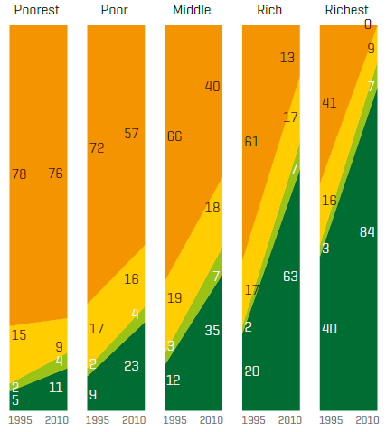
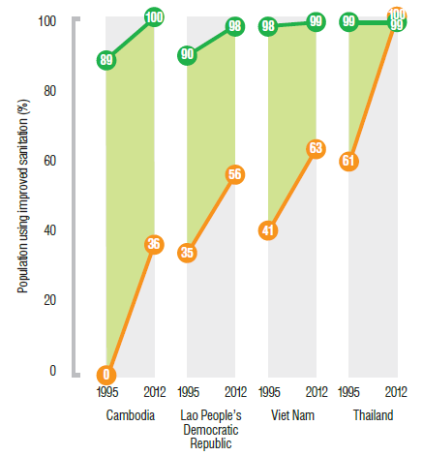
between wealth quintiles

Slide 23
Monitoring 6.3 (WHO, UN-Habitat, UNEP)
6.3.1. Wastewater treatment
Ratio: safely treated / total
Multi-sectoral
  Domestic wastewater
  (sewage + faecal sludge)
  Drawn from 6.2.1
  Hazardous industrial wastes (point sources)
Data from:
  JMP, AQUASTAT, IB-NET (domestic wastewater)
  National inventories of industries (hazardous wastes)
6.3.2. Ambient Water Quality
Key water bodies
Water Quality Index
  Total dissolved solids
  Dissolved O₂
  Dissolved inorganic N
  Dissolved inorganic P
  E. coli
Multiple rungs
  # of noncompliant parameters,
  WQ index, more parameters
Data from GEMS/Stat (in situ and modeled), OECD, remote sensing

Slide 24
Monitoring 6.4 (FAO-AQUASTAT+)
6.4.1* Efficiency
Ratio: value added to volume water used
Change over 3-5 year period
Multi-sectoral
  Agricultural
  Industrial
  Energy
  Municipal supply
Data from AQUASTAT (including national sources), World Energy Outlook, IB-NET …
6.4.2* Water stress
Ratio: total freshwater withdrawn to total renewable resources
  Reserving environmental water requirements
Multi-sectoral
  Agricultural
  Industrial
  Municipal supply
Data from AQUASTAT (including national sources)

Slide 25
Monitoring 6.5 and 6.6 (UNEP+)
6.5.1* IWRM implementation
Composite indicator
  Policies
  Institutions
  Management tools
  Financing
Equal weighting,
score 0-100
Data from national surveys completed by ministries and consultations
6.6.1* Ecosystems
Percentage of change in water-related ecosystems extent overtime
  Wetlands, forests and drylands
    Wetlands: marshes, fens, swamps, ponds, lakes, rivers, aquifers…
Extent, (Quantity, Quality, Status)
Data from ground data + Earth Observations
Reporting on UNEP-Live platform

