Slide 1
2016 SWA Meeting of Ministers of Water, Sanitation and Hygiene: Ministerial Meeting
Addis Ababa, Ethiopia, 15 and 16 March
Building blocks to achieve WASH targets of the SDGs
Examples from Europe, Africa & Latin America
Jaime Melo Baptista (Portugal)
Former Chairman of the Portuguese Regulator (ERSAR)
President of the Strategic Council of PWP Member of the Board of IWA
Principal Research Officer at LNEC

Slide 2
Public policy
How the different countries around the world can comply with the new SDG and other international policy frameworks?
With a sound “public policy” for water!
What it means?
Means a set of interrelated components (blocks) wisely managed.
An holistic and multidisciplinary approach is needed for the success of the public policy.
And a genuine politic commitment is absolutely essential!

Slide 3
Public policy
Public policies for water must in general include the following building blocks:
Strategic plans.
Legislative framework.
Institutional framework.
Governance models.
Service access targets.
Quality of service goals.
Tariff policy.
Tax policy.
Financial resources.
Public policy as a set of blocks

Slide 4
Public policy
Construction of infrastructures.
Operation of infrastructures.
Human resources.
Research and innovation.
Entrepreneurship.
Competition.
Consumers protection.
Social engagement.
Ethics and integrity.
Data and information.
Correct approach + tools + skilled staff!
Public policy as a set of blocks

Slide 5
Regulation
Regulators have an important role:
Regulation should be seen as one block of public policies on water services, one out various.
But it has a very important role given the fact that it promotes and or controls the remaining blocks.
Regulation provides also monitoring & accountability.
It is increasing the number of countries with regulators:
165 regulators?
Public policy as a set of sprocket-wheels

Slide 6
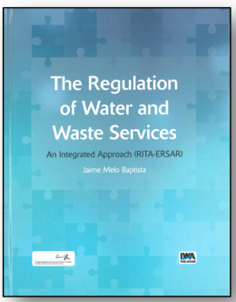
Regulation
Regulatory model:
Structural regulation of the sector:
Contribution to the organisation of the sector.
Contribution to the legislation of the sector.
Contribution to the information of the sector.
Contribution to the capacity building of the sector.
Behavioural regulation of the utilities:
Legal and contractual regulation.
Economic regulation.
Quality of service regulation.
Drinking water quality regulation.
Consumers interface regulation.

Slide 7
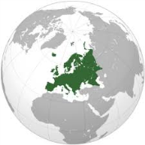
Global vision about Europe
Stable water public policies in Western Europe but still fragile public policies in Central & East Europe.
28 water regulators, mainly national authorities, with a large increase in Central & East Europe.
Albania, Armenia, Belgium, Bulgaria, Croatia, Denmark, England and Wales, Estonia, France, Greece, Hungary, Ireland, Italy, Kazakhstan, Kosovo, Latvia, Lithuania, Malta, Northern Ireland, Portugal, Romania, Scotland, Slovakia and Ukraine (+?)
56% of the countries has a regulatory authority.
2 regional regulatory networks.
European Water Regulators Network (WAREG), Energy Regulators Regional Association (ERRA).
Good, fair & poor compliance with SDG.
A significant effort on sound public policies and strong regulatory authorities are needed in some countries.

Slide 8
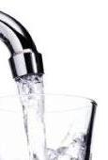
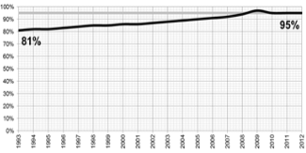
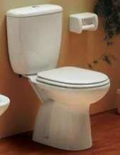
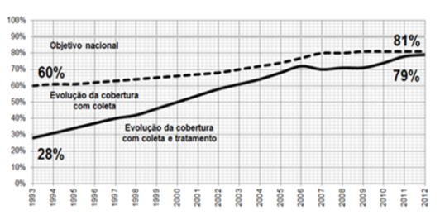
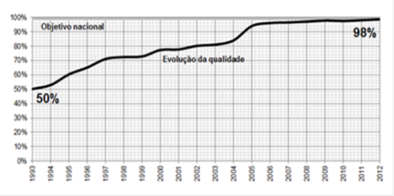
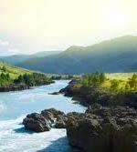
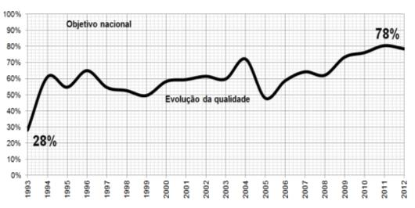
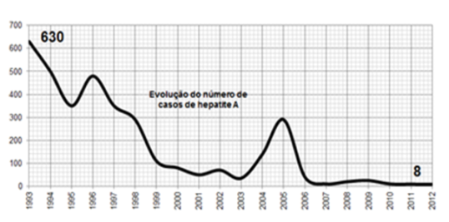
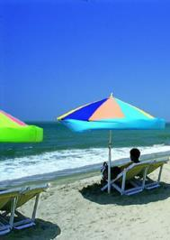
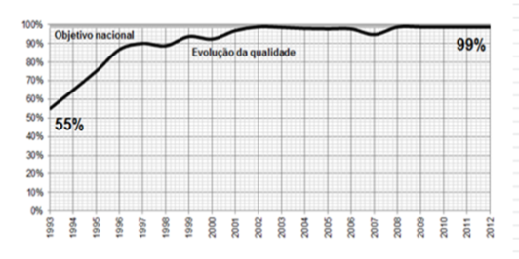
Case study: Portugal
The Portuguese public policy (1993-2015) was successful for citizens, economy, public health & environment:
Access to water supply
81% ⇨ 95%
Access to wastewater
28% ⇨ 79%
Drinking water quality
50% ⇨ 98,4%
Surface waters quality
28% ⇨ 78%
Hepatitis A
630 ⇨ 8
Coastal waters quality
55% ⇨ 99%

Slide 9
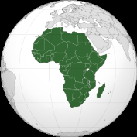
Global vision about Africa
In general lacking water public policies in Africa.
13 regulators, mainly national ones.
South Africa, Gambia, Ghana, Cape Verde, Mauritania, Mozambique, Niger, Kenya, Rwanda, Tanzania, Zambia, Mali and Malawi (+?).
24% of the countries has a regulatory authority.
2 regional regulatory networks.
African Forum for Utility Regulators (AFUR) and Eastern and Southern Africa Water and Sanitation Regulators Association (ESAWAS).
In general poor compliance with SDG and big challenges ahead.
A strong effort on sound public policies and strong regulatory authorities are needed.
Development funding would be much more effective!

Slide 10
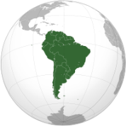
Situation in Latin America
In general lacking water public policies in South & Central America, with some good situations.
62 regulators, some national some regional.
Anguilla, Argentina, Bahamas, Barbados, Belize, Bolivia, Brazil, Chile, Colombia, Costa Rica, Ecuador, Guyana, Honduras, Jamaica, Nicaragua, Panama, Paraguay, Peru, Trinidad and Tobago and also Uruguay (+?).
100% of the countries have a regulatory authority.
1 regional regulatory network.
Association of Regulatory Bodies for Drinking Water and Sanitation for the Americas.
In general poor compliance with SDG and big challenges ahead.
A strong effort on sound public policies and strong regulatory authorities are needed.
Development funding would be much more effective!

Slide 11
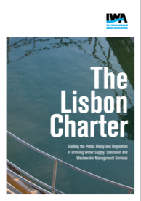
Final remarks
An sound, holistic and multidisciplinary public policy is an essential tool to achieve SDG!
Regulation promotes or controls most of the components of the “public policy”.
Additionally we need:
Short, medium & long term approach.
Stability across time.
Efficiency and effectiveness.
Clear roles for the stakeholders.
Transparency and accountability.

Slide 12
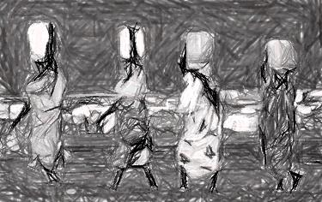
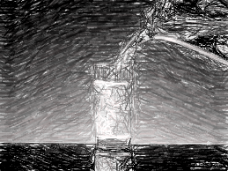
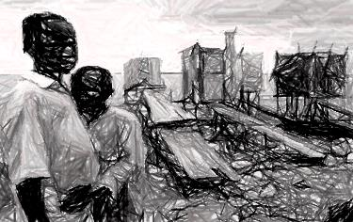
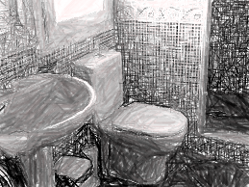
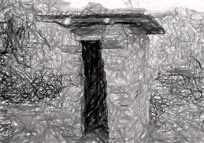
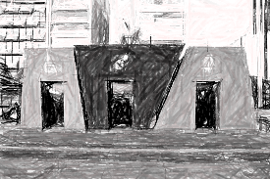
Thanks for your attention!
jmbaptista@lnec.pt
Portugal

